Slide 1
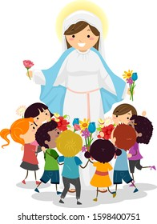
Blessed with a faithful mother

Slide 2
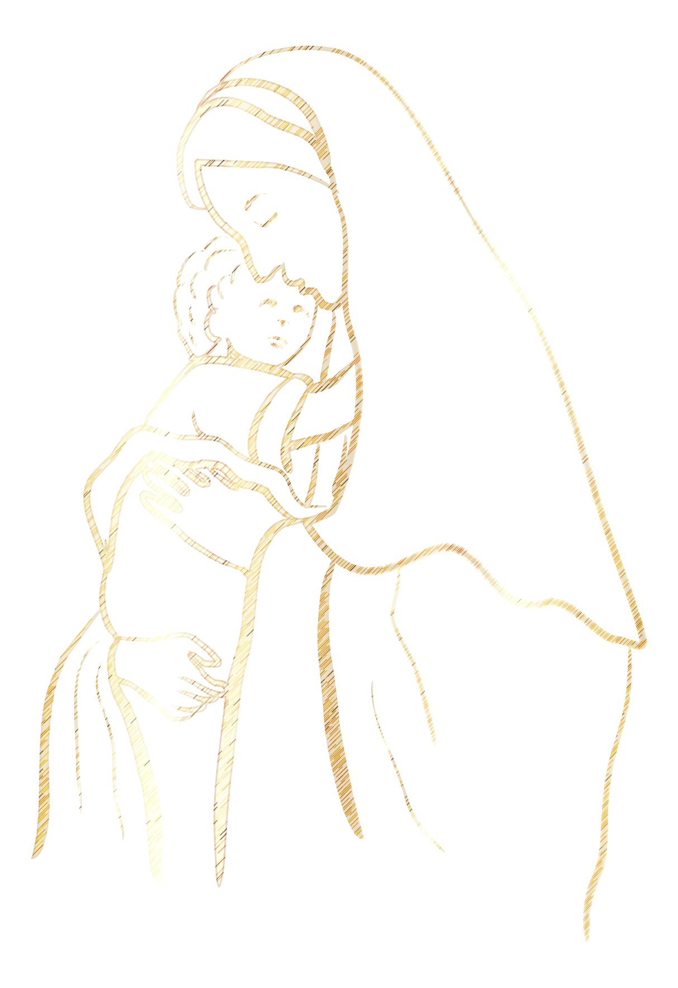
‘Mama Mary’
{Chorus}
Mama Mary help me be open,
To let the light shine through me
Mama Mary teach me obedience,
Make me transparent like you

Slide 3
Behold the handmaid of God,
May all you herald come true
In Him alone I am satisfied,
Forever blessing His name!
Mama Mary help me be open,
To let the light shine through me
Mama Mary teach me obedience,
Make me transparent like you

Slide 4
My soul rejoices in God,
His word has blossomed in me
From now all ages will honor Him,
Forever blessing His name!
Mama Mary help me be open,
To let the light shine through me
Mama Mary teach me obedience,
Make me transparent like you

Slide 5
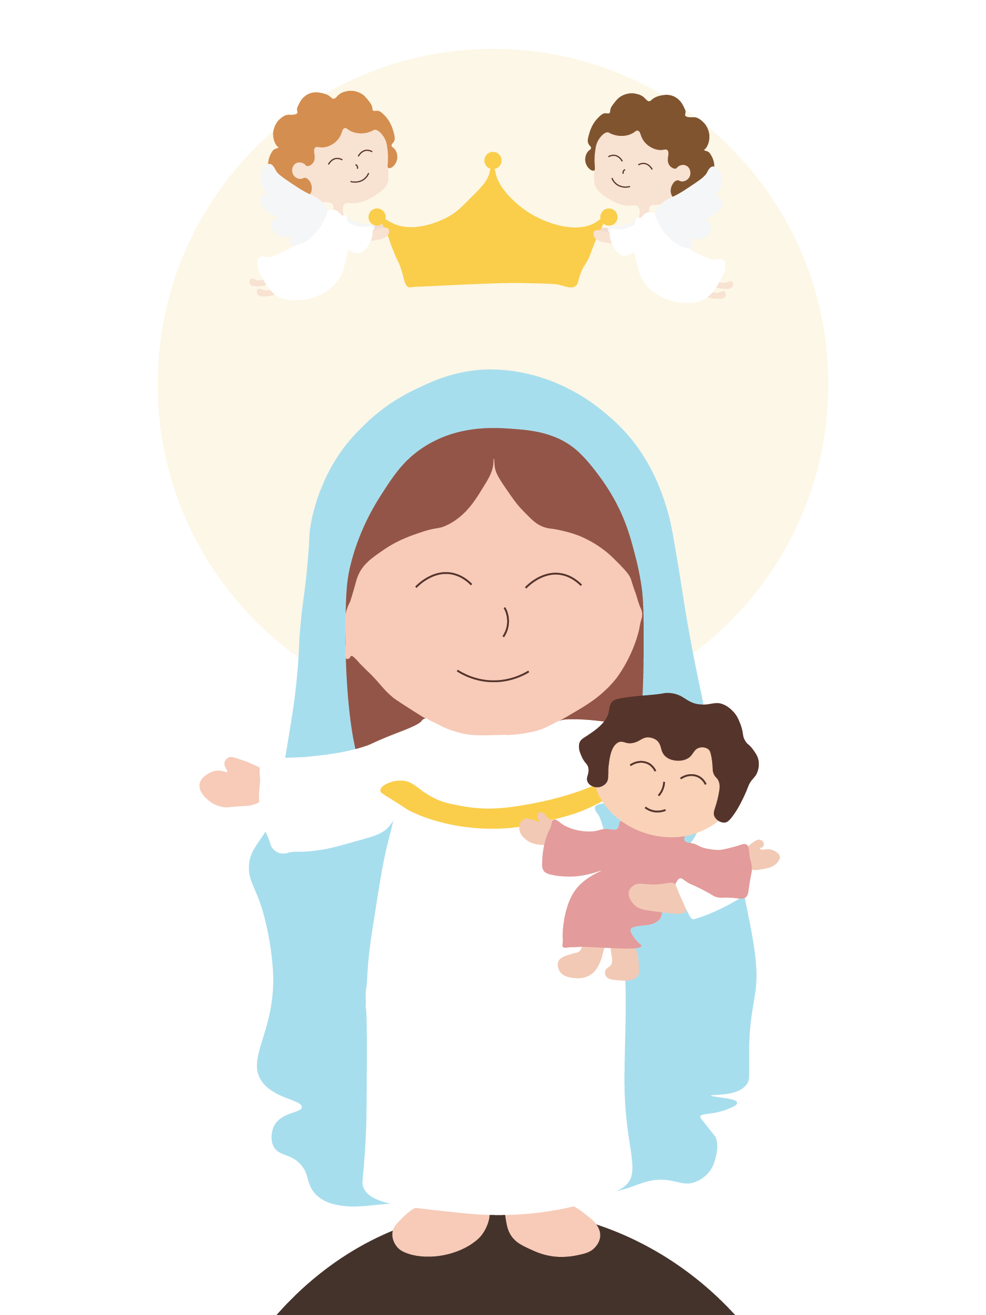
OUR LADY OF LIGHT

Slide 6
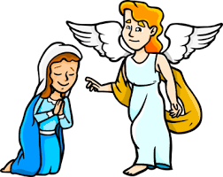
“Hail, favored one! The Lord is with you.” - Luke 1:28

Slide 7
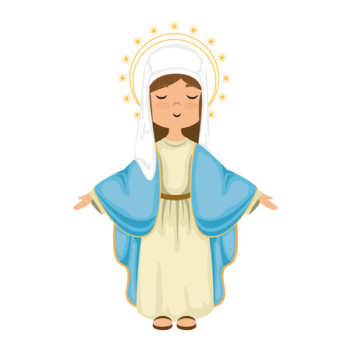
FAITHFUL

Slide 8
JOYFUL

Slide 9
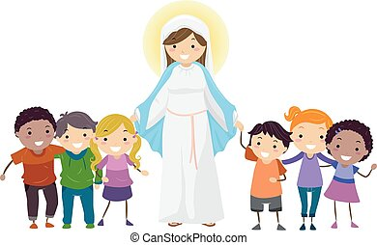
HELPFUL

Slide 10
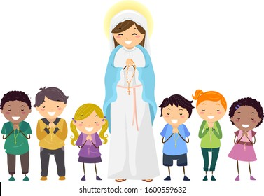
ACTIVITY
Pray the Rosary

Slide 11
Blessed with a faithful mother

