Slide 1
I AM
BLESSED
WITH FRIENDS
AUGUST Kids Assembly

Slide 2
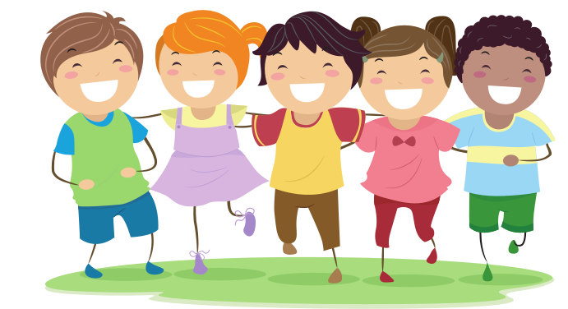
WATCH,
SING &
DANCE

Slide 3
WE ARE BLESSED TO HAVE FRIENDS

Slide 5
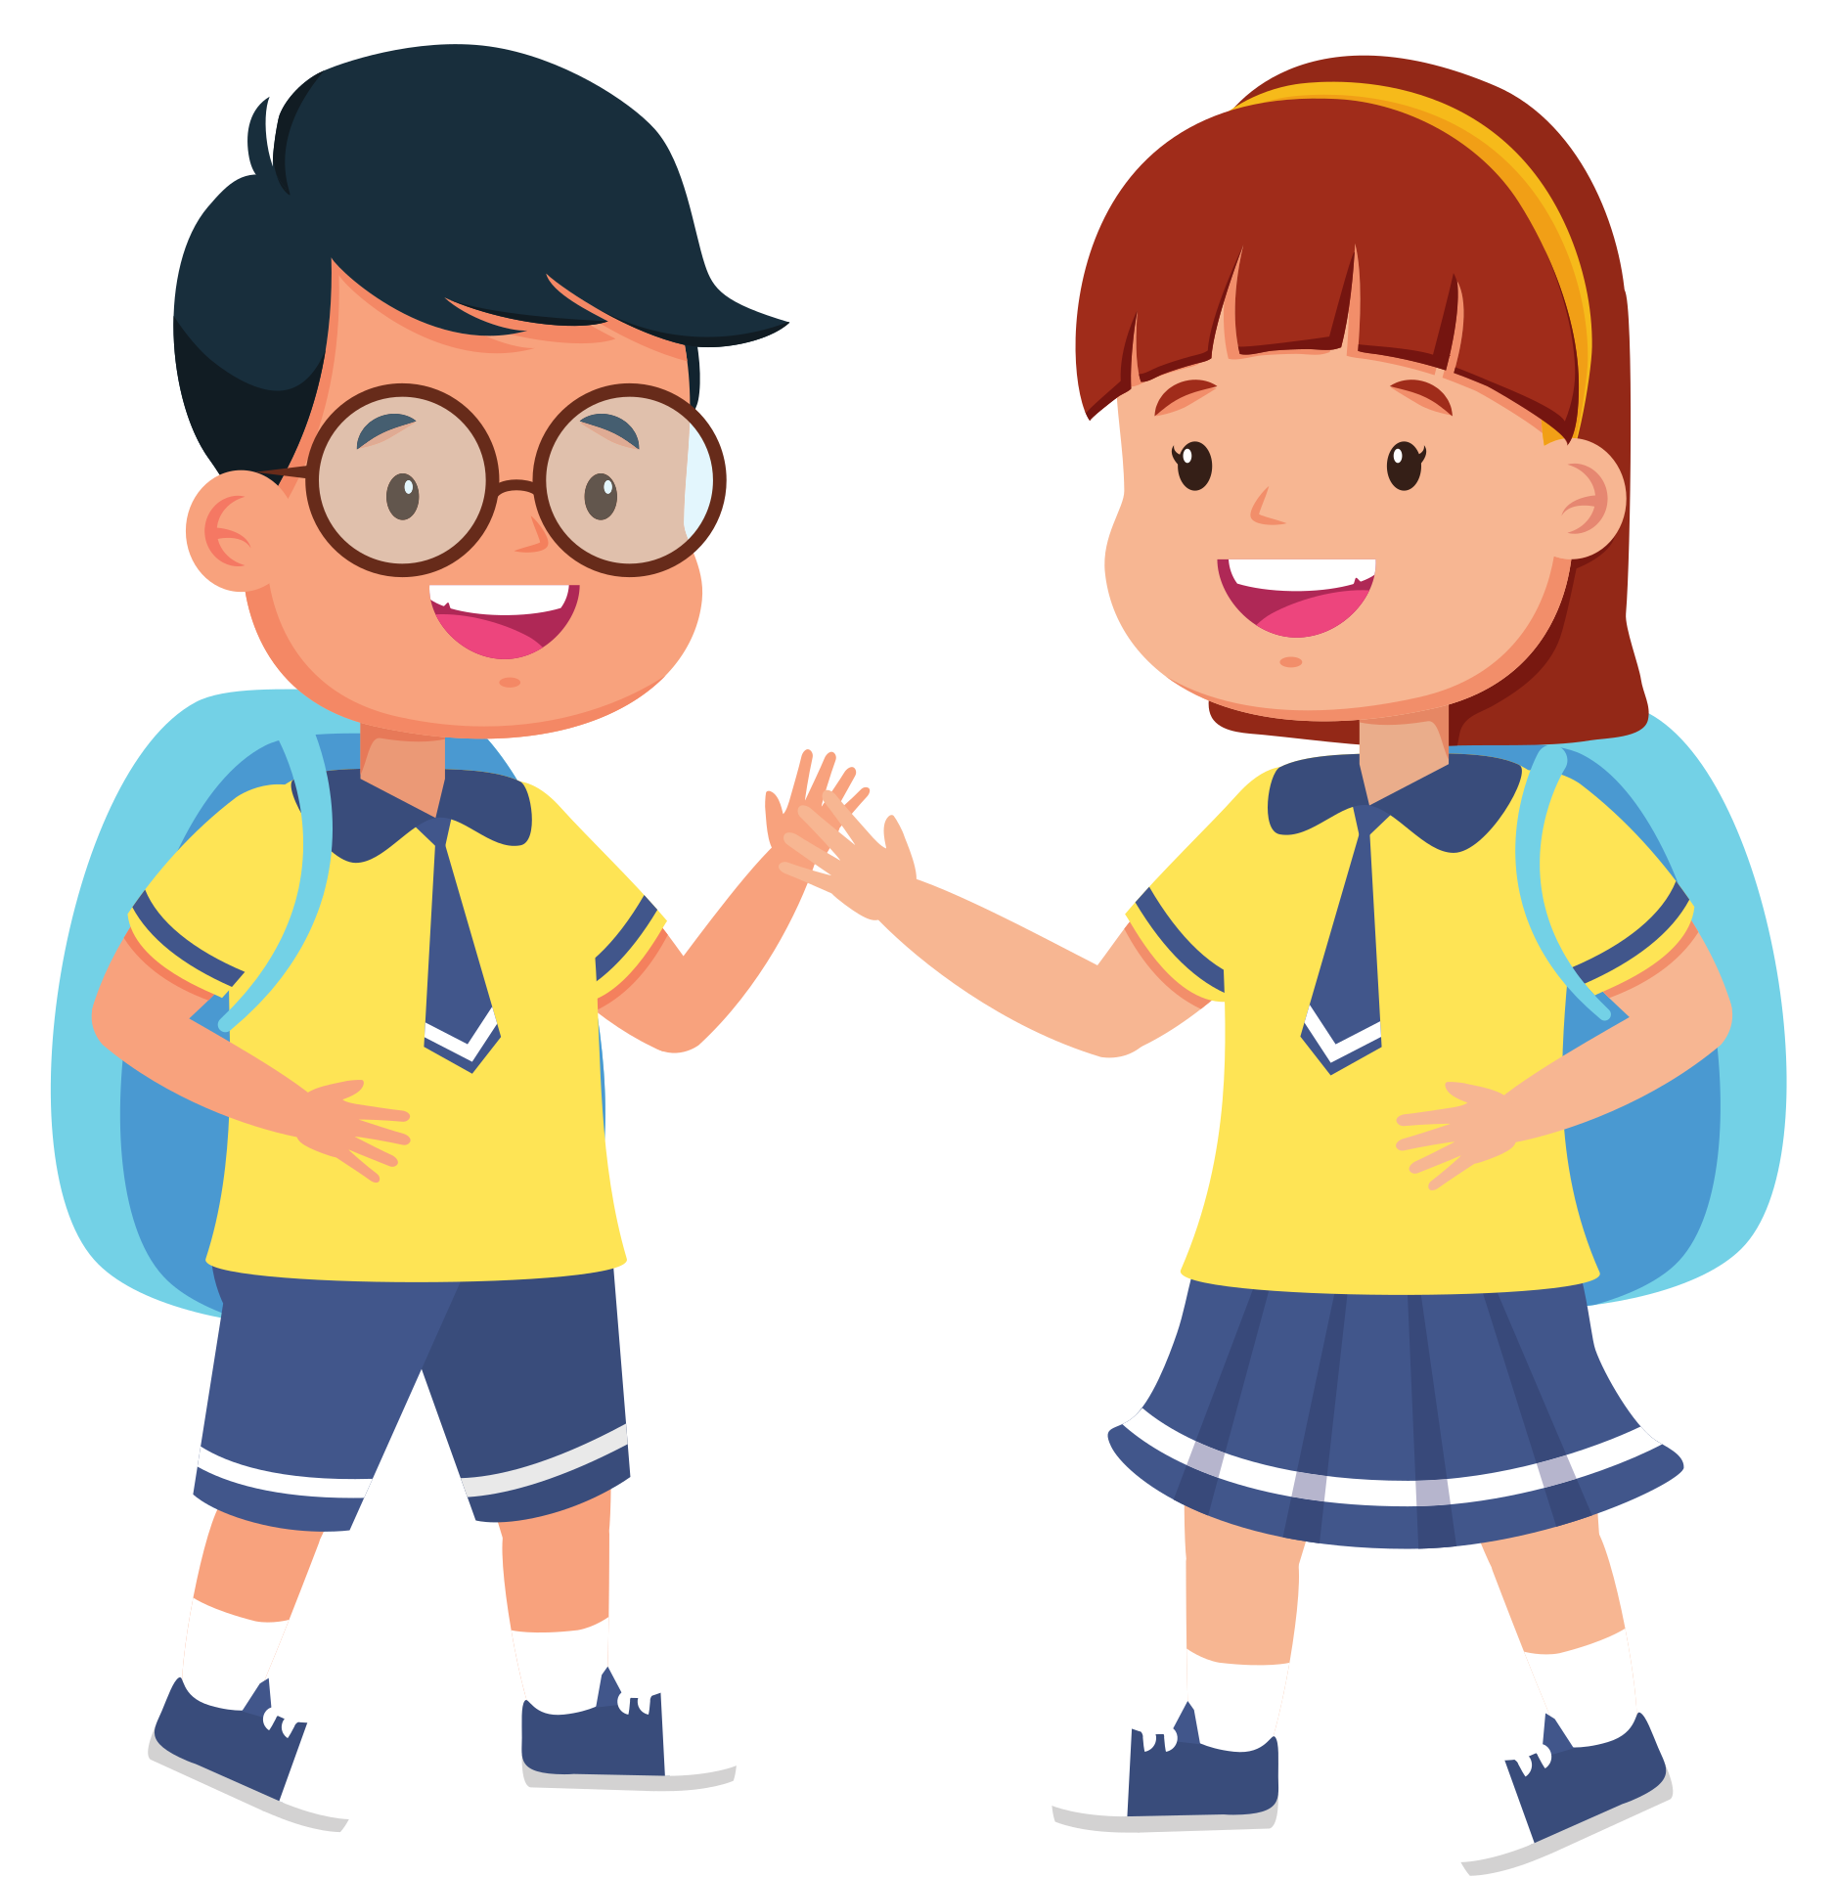
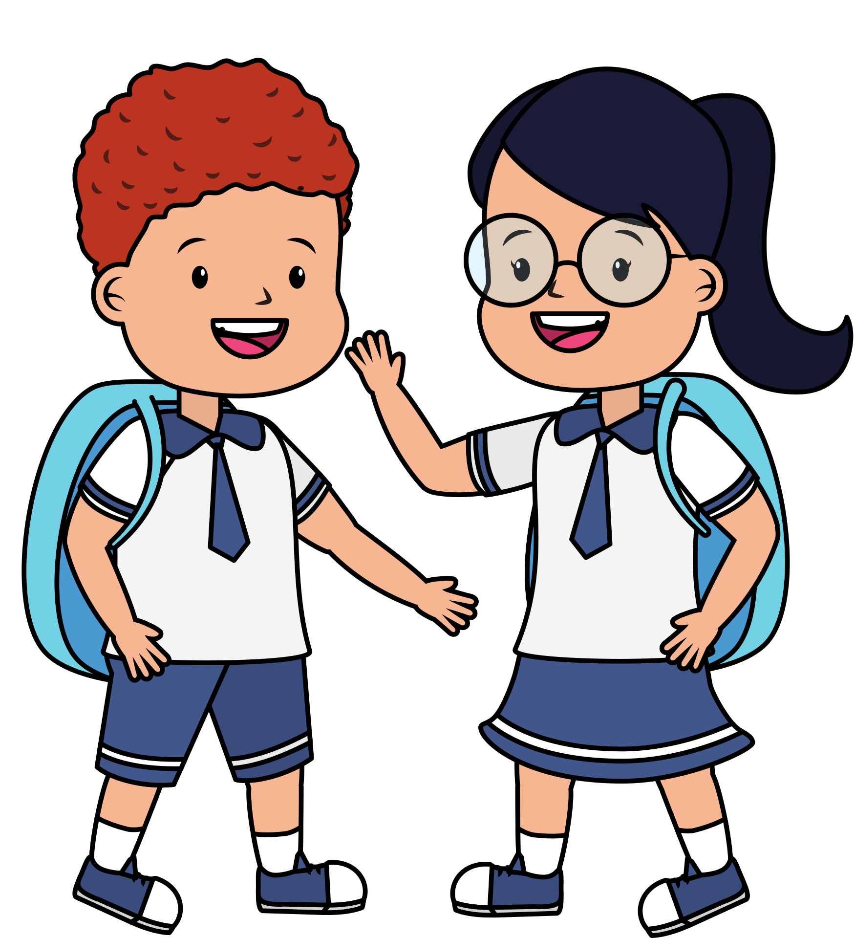
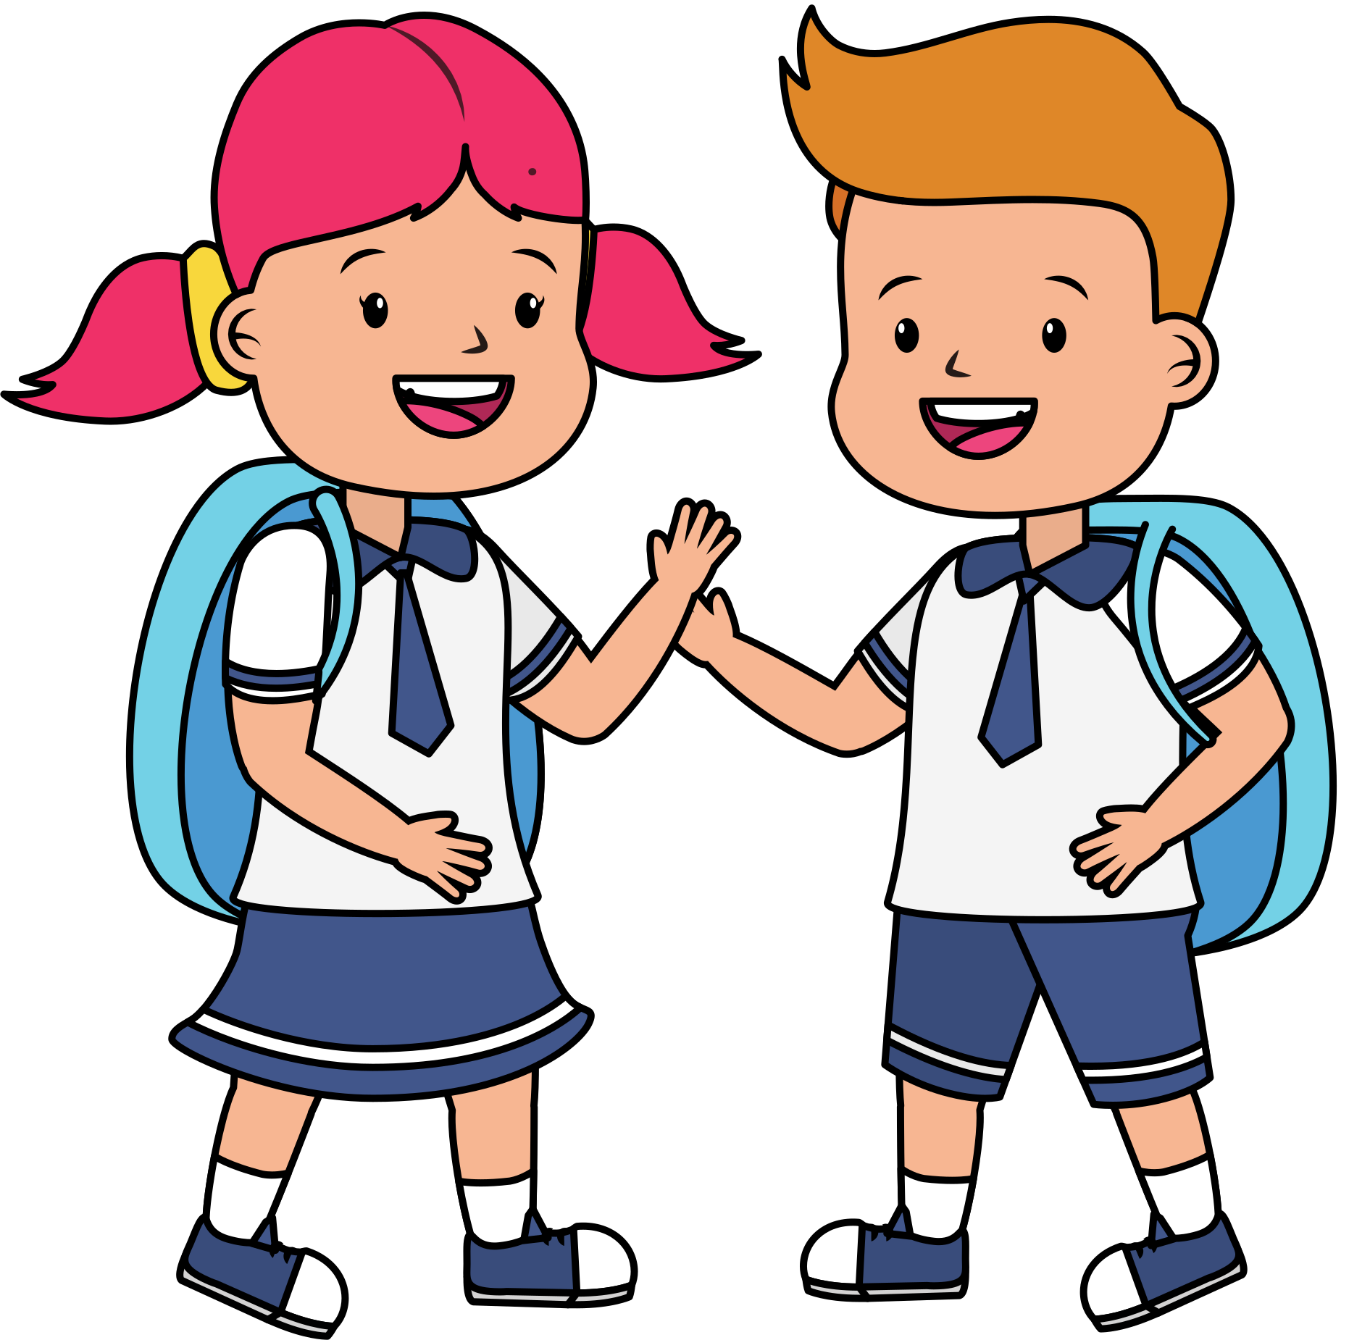
OUR FRIENDS ARE GOD'S GIFTS

Slide 6
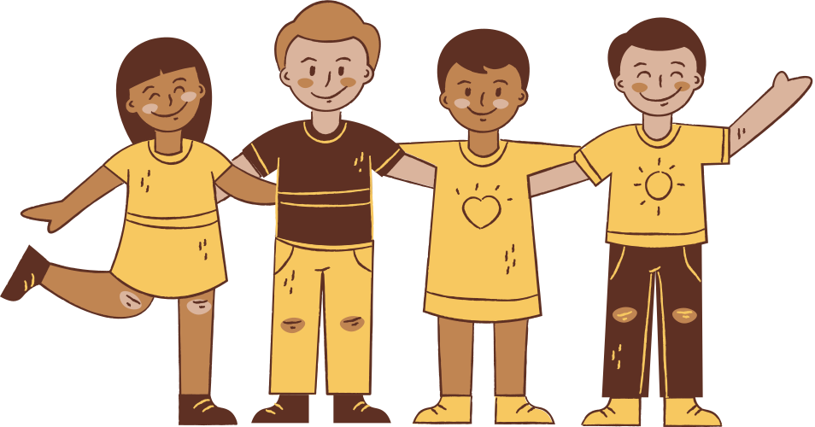
MFC KIDS PROMISE #4
I WILL TELL OTHERS ABOUT JESUS
I WILL LOVE MY ... FRIENDS
BY DOING GOOD DEEDS EVERY DAY
THAT WILL REFLECT GOD’S LOVE.

Slide 7
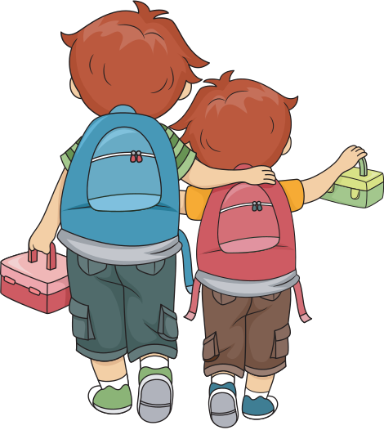
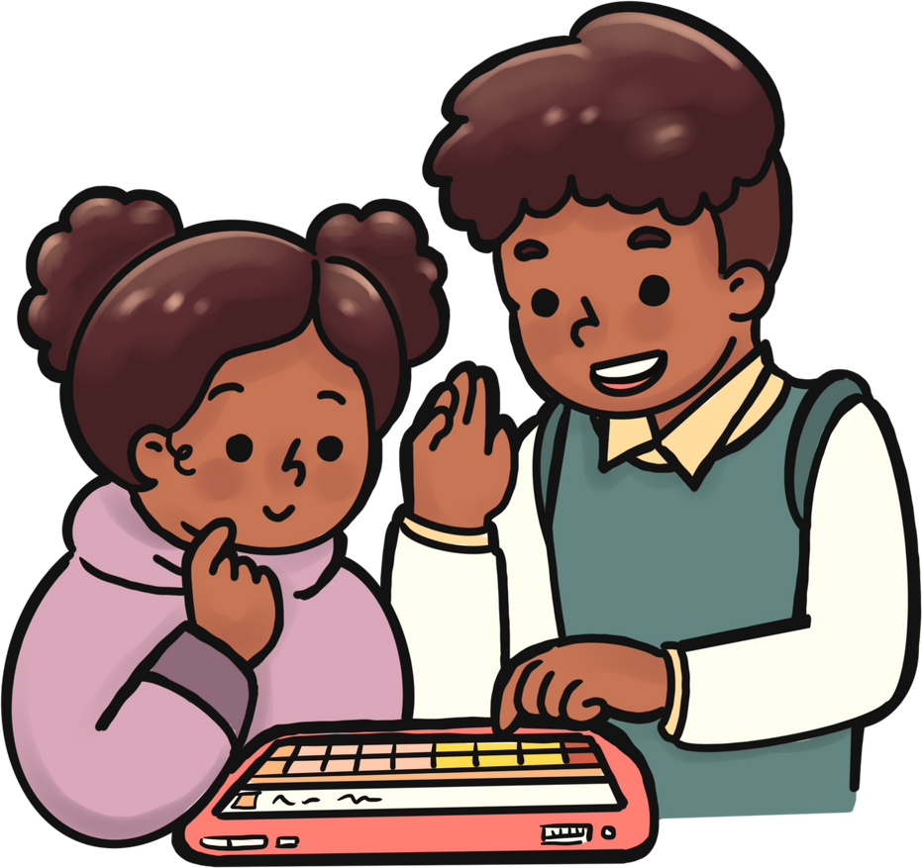
THEY ARE LIKE BROTHERS & SISTERS TO US

Slide 8
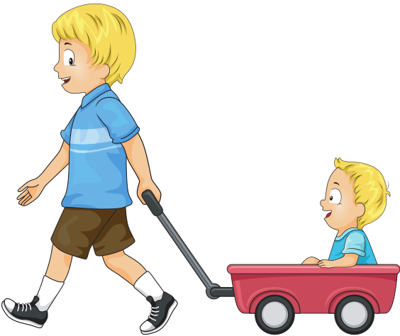
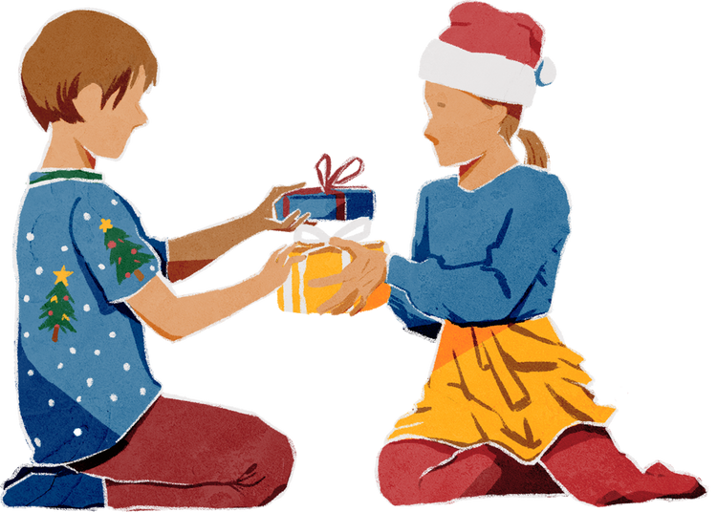
BY DOING
GOOD DEEDS EVERYDAY

Slide 9
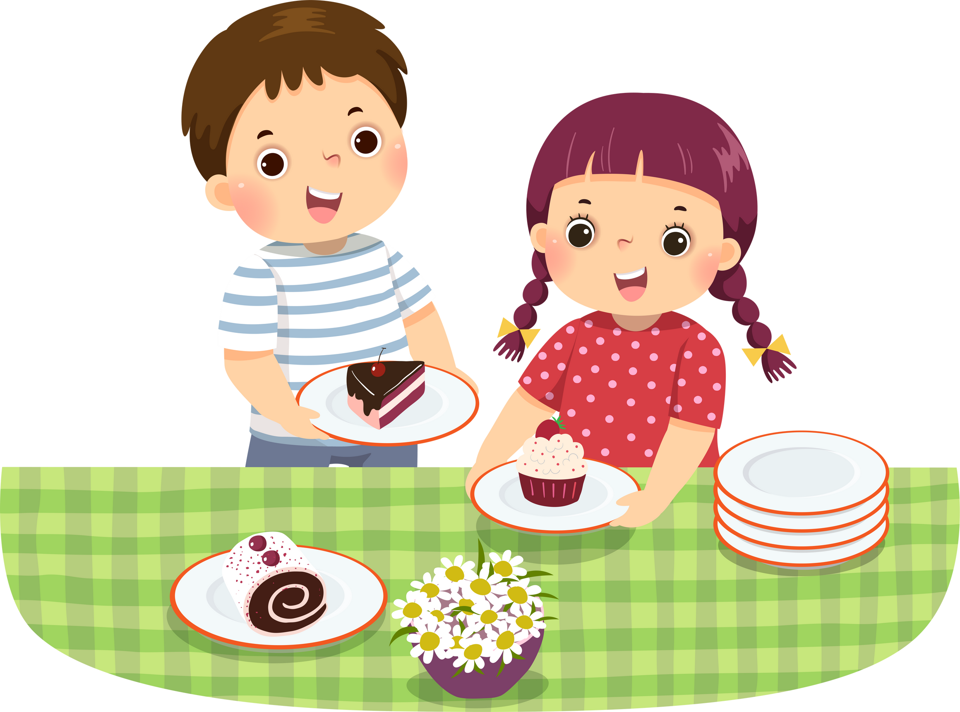
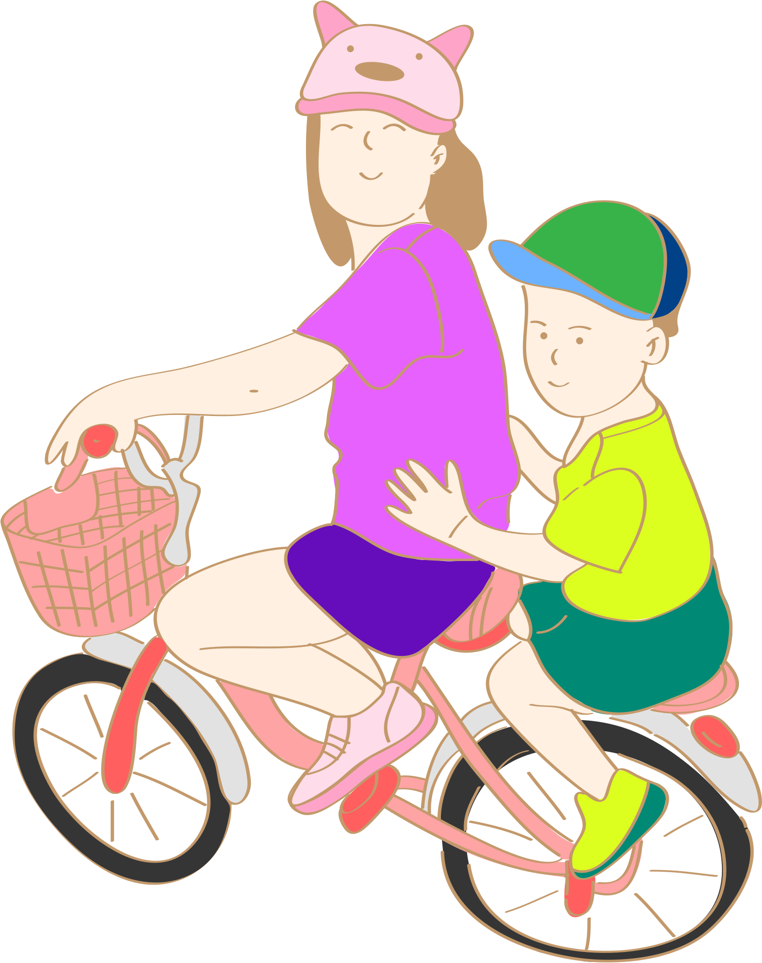
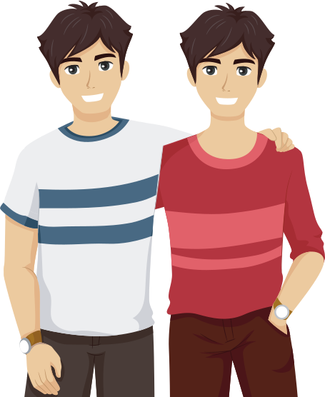
BY BEING AVAILABLE
FOR THEM

Slide 10
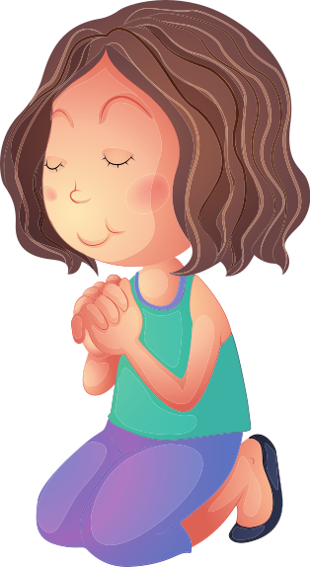
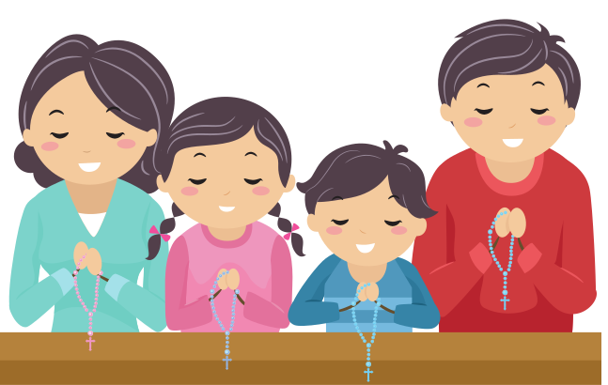
BY PRAYING
FOR THEM

Slide 11
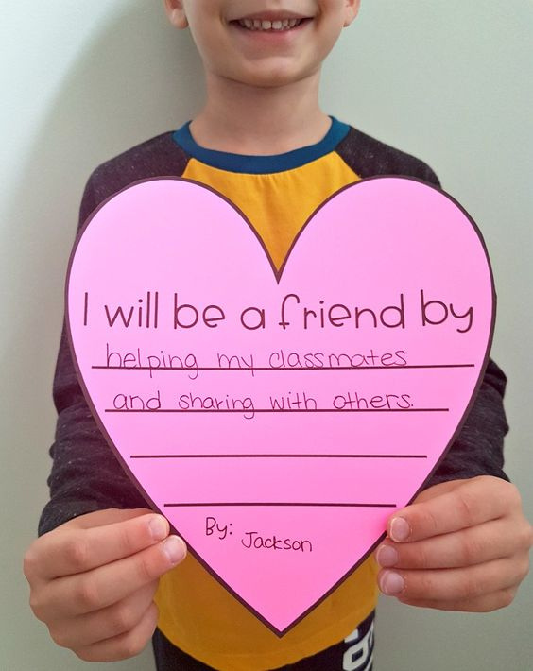
HEART
FOR FRIENDS
Colored Paper
Scissors
Coloring Materials
MATERIALS

Slide 12
DRAW A BIG HEART ON YOUR COLORED PAPER.
CUT OUT YOUR DRAWING. ASK HELP FROM YOUR PARENTS OR GUARDIANS IN CUTTING THE DRAWING.
WRITE THE WORDS “I WILL BE A FRIEND BY… THEN PUT YOUR ANSWER IN THE MIDDLE OF THE HEART.
WRITE YOUR NAME AT THE BOTTOM OF THE HEART.
TAKE A PICTURE OF YOU WITH YOUR ARTWORK AND POST IT IN SOCIAL MEDIA. IF YOU DON’T HAVE, YOU MAY ASK YOUR PARENTS TO POST IT FOR YOU.

Slide 13
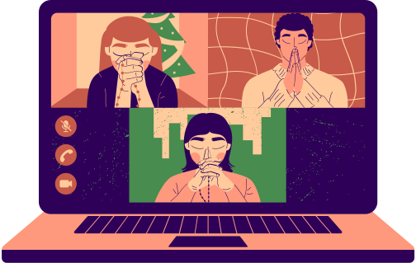
HOUSEHOLD DISCUSSION
WHO/WHAT IS A FRIEND FOR YOU? AND WHY ARE THEY IMPORTANT?
HOW CAN YOU BE A BLESSING TO YOUR FRIEND/S?

Slide 15
I AM
BLESSED
WITH FRIENDS
AUGUST Kids Assembly

