Slide 2
Blessed with my Parents!
April Kids Assembly

Slide 3
Let's have a quick game!
FAMILY PORTRAIT DISPLAY

Slide 9
Our family is one of the greatest gifts from God.

Slide 10
Our parents nurture us, love us, feed us, teach us, and take care of our needs according to their capabilities.

Slide 11
God commands us to respect our father and mother.

Slide 12
CHOOSE TO LOVE THEM

Slide 13
CHOOSE TO FORGIVE THEM

Slide 14
CHOOSE TO PRAY FOR THEM

Slide 15
ACTIVITY

Slide 16
FAMILY COLORING PAGE
Kids at Play
(3-4 years old)

Slide 17
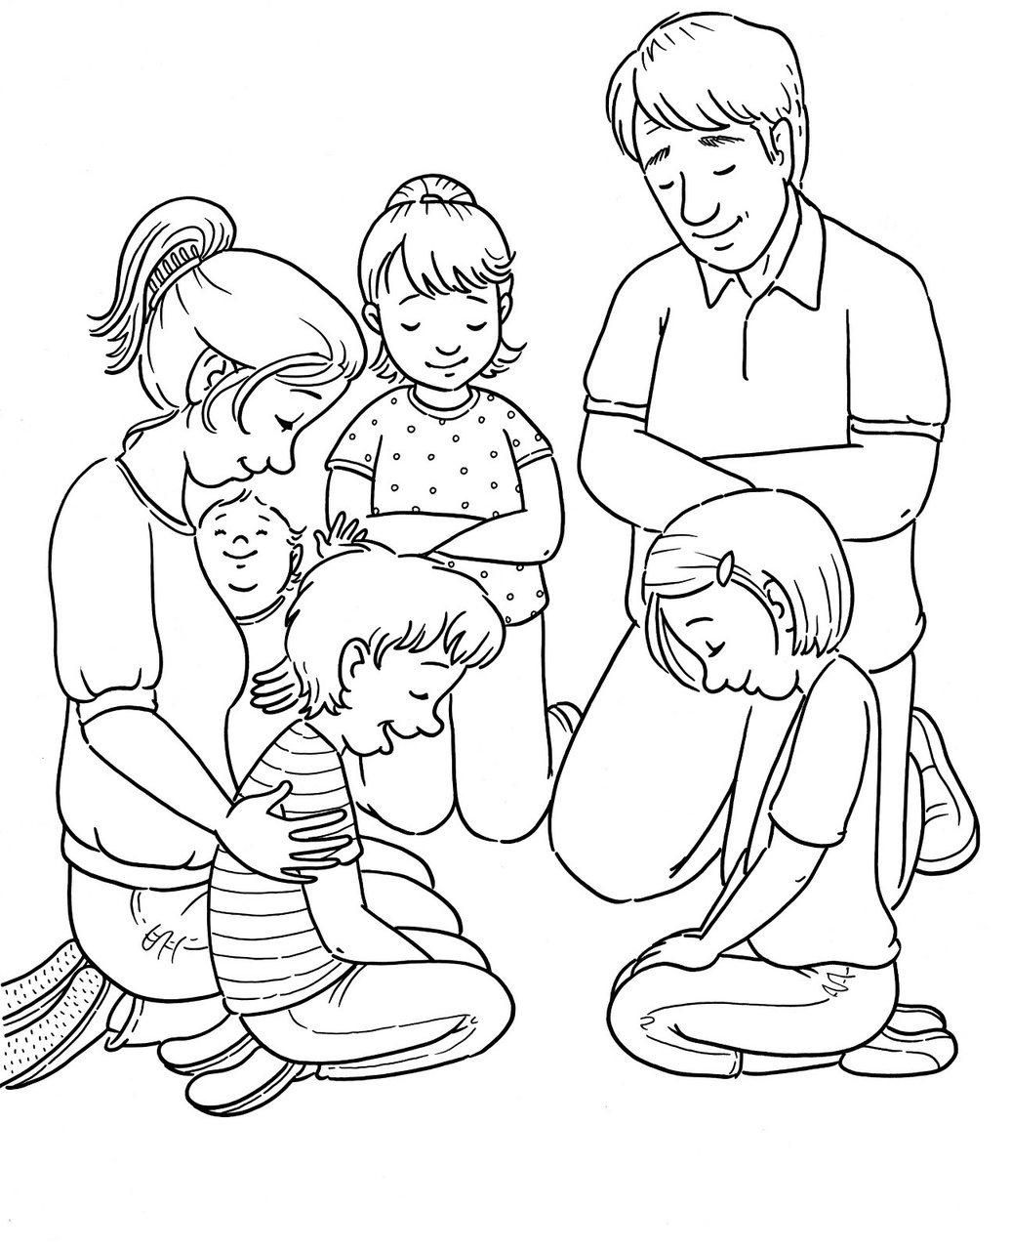

Slide 18
'MY FAMILY'
DRAWING
First Steps
(5-7 years old) and Footsteps
(8-10 years old)

Slide 19
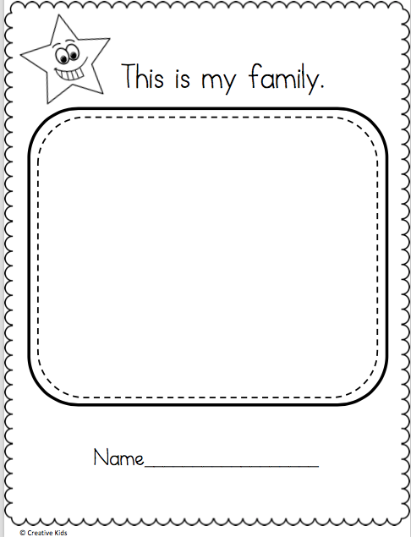

Slide 20
HOUSEHOLD
Step Up
(10-12 years old)

Slide 21
·Share a perfect moment with your parents.
·How can you build more perfect moments with your parents?

Slide 22
God has a beautiful plan for our families.

Slide 23
Lord God,/ you are our Father in heaven./ You gave us our parents to take care of us/ and to love us here on earth./ Bless our family relationships./ Send your Holy Spirit/ to inspire us and to guide us as we grow in wisdom and understanding./ Open our hearts and minds/ that we may see you in our parents./ That we may remember that you gave us life through them./ Help us to love unconditionally./
Give us the grace to forgive each other for the hurts that we have caused. / Forgive us/ especially for the times when we have been disobedient. / Help us to grow in trust and confidence in your great plan for us/ and fix our eyes on Jesus, especially during difficult times. /

Slide 24
Gift Badge
for April

Slide 25
MFC Kids Promise
1. I will imitate Jesus.
• I will pray to God and read the Bible every day.
• I will make Jesus my role model by obeying rules and doing good in school.

Slide 26
MFC Kids Promise
1. I will be a good family member.
I will be a good son/daughter to my parents by obeying and respecting them.
• I will be a good sister/brother to my siblings by sharing and supporting them.

Slide 27
MFC Kids Promise
1. I will be an active member of MFC Kids
• I will always attend and participate in all MFC Kids activities.
• I will share my time, talents, and treasures to others, especially to my brothers and sisters in MFC Kids
• I will love, respect, and be loyal to my MFC Kids family.

Slide 28
MFC Kids Promise
4. I will tell others about Jesus.
• I will love my brothers and sisters, relatives, and friends by doing good deeds every day that will reflect God's love.
• I will serve in our Parish Church.
• I will love the poor by sharing what I have with them

Slide 29
Blessed with my Parents!
April Kids Assembly

